Slide 1
HISTORY OF PUBLIC EDUCATION & WHO HAS BENEFITTED 1600-2011

Slide 2
4 Competing American Traditions Shape Public Education, the first 3 most often complementing each other…
The Promotion of Christianity
To Develop and Strengthen a Capitalist, Free Market Economy
To Build Patriotism, National Loyalty and Exert Social Control
To Serve as the Most Significant Resource in Guaranteeing Equality, Democracy and Liberation

Slide 3
PUBLIC EDUCATION TO PROMOTE CHRISTIANITY

Slide 4
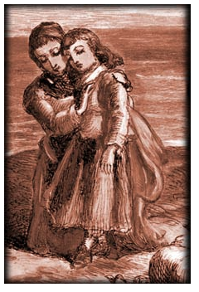
ORIGINAL SIN
The Puritans believe that children are born close to the Devil, and the role of society and family is to wrestle Satan from within the child.

Slide 5
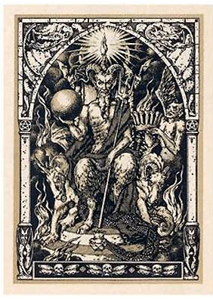
FIRST PUBLIC SCHOOLS
Massachusetts’ Old Satan Deluder Act of 1647 establishes first public school system. Since, Puritans believed that children were born with the “original sin,” they had to be raised in an atmosphere of fear, strict discipline, hard work, and a strong knowledge of the Bible to delude Satan.

Slide 6
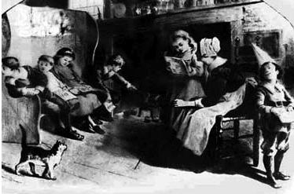
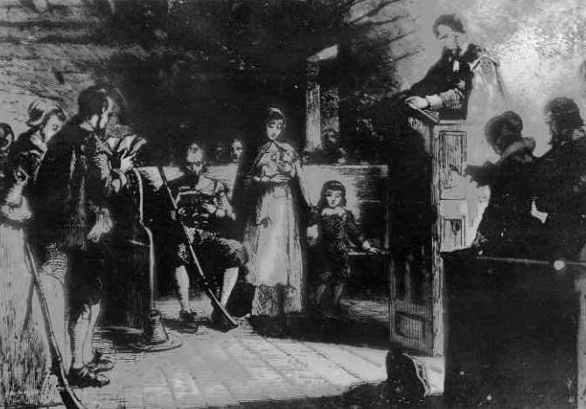
SCHOOLS LOOK AND RUN LIKE PURITAN CHURCH
Teachers established as all-knowing, and students as empty vessels. The system of an instructor lecturing from the front of a class, with students sitting in stiff rows and memorizing information rather than building critical thinking skills, remains the norm to this day.

Slide 7
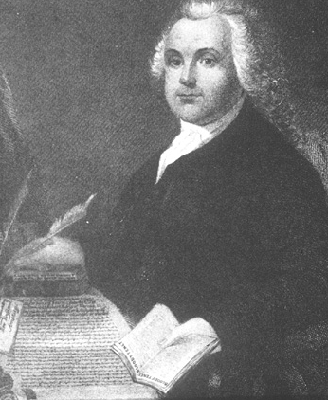
MYTH OF SEPARATION OF CHURCH AND STATE
Roger Williams, a strict Puritan, argued for the separation, but never intended to limit religious teaching in public school classrooms. He believed that the ruling elite in the Massachusetts colony were be-coming too involved in determining who could vote based on how close they were to God. The Separation Doctrine was originally intended to insure that only God could determine who was close to him.

Slide 8
FIRST INDIAN BOARDING SCHOOLS
Throughout U.S. history, missionaries establish schools to Christianize indigenous children, freed slaves and new immigrants. This begins first with Harvard University, which in 1614 was founded by the Society for the Propagation of the Gospel and included in its mission the conversion of Indian children to Christianity, considered the first Indian Boarding School. Once Harvard became known as a prestigious university, this mission was abandoned. Yale University was founded in 1701 also for the purpose of “saving” the souls of Indian youth. Despite the fact than Indian communities rejected the schools from the start, and those youth in boarding schools faced great hardships, confusion and disease, the practice became not only church but government policy throughout North America until the 1950s, and continued by removing the majority of indigenous children from their homes through foster care system through the 1970s.

Slide 9
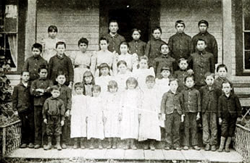

Slide 10
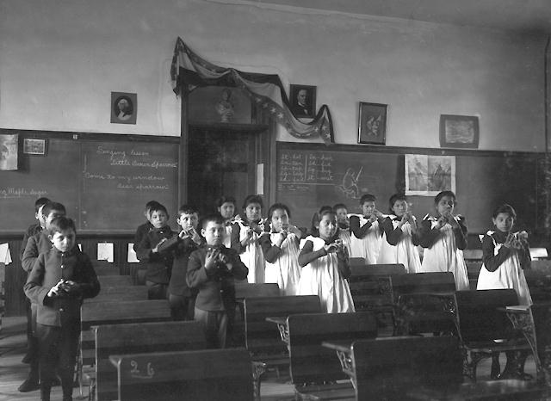

Slide 11
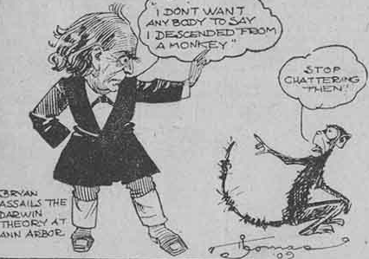
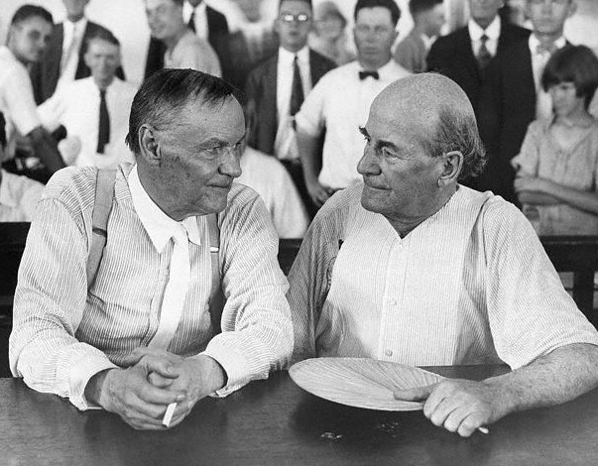
THE ATTACK ON EVOLUTION
At the 1925 Scopes Monkey Trial, Clarence Darrow for the ACLU lost the argument that Separation of Church and State and the rights of teachers to free speech supported the teaching of evolution. Christian fundamentalists won the right of local communities to run their own schools, including choosing curriculum.

Slide 12
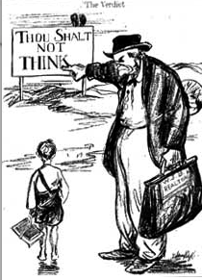
TODAY…
Christian fundamentalists have organized over the past 40 years to take over local school boards, dominate curriculum selection, censor books and remove them from community and school libraries, protect and expand prayer and religious teaching in public school classrooms, remove sex education and contraception from schools, privatize school systems through vouchers and charters in order to expand public funding of Christian (Protestant and Catholic) schools. The base built to control school districts was also used to build the Religious Right’s growing influence over the Republican party and politics from the school house to the White House.

Slide 13
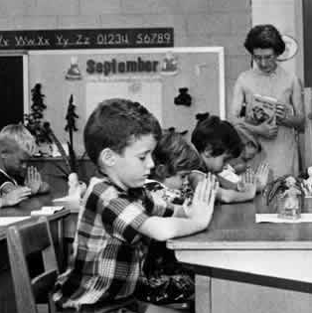

Slide 14
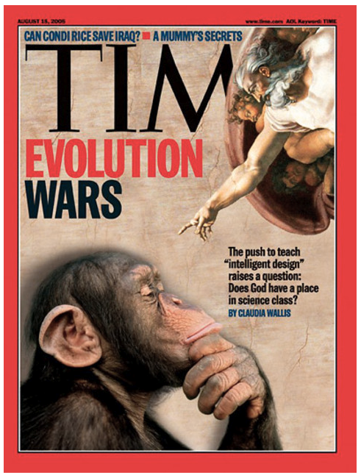

Slide 15
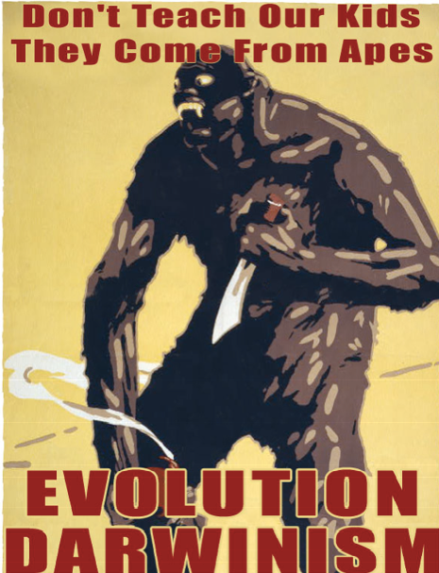

Slide 16
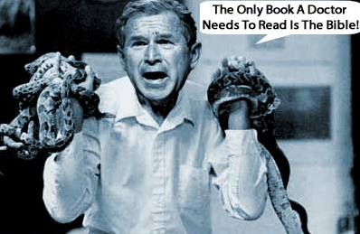
From Creationism to Intelligent Design

Slide 17
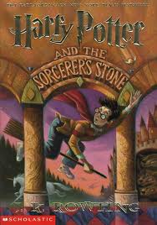
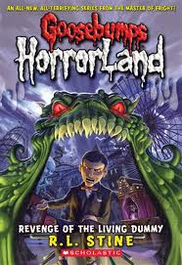
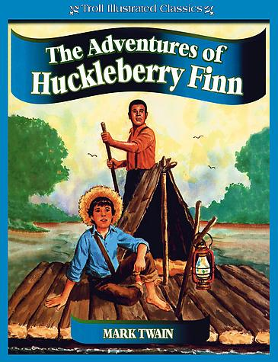
REMOVED FROM SCHOOL CLASSROOMS AND LIBRARIES:
CONSIDERED TO PROMOTE SATAN WORSHIP
CONSIDERED TO PROMOTE RACE-MIXING

Slide 18
PUBLIC EDUCATION TO SUPPORT CAPITALISM

Slide 19
Before 1890, there is no such concept as adolescence. Young people are in fact young adults, and at 13, are expected to be laborers, farmers, soldiers, even parents. Only upper classes have access to higher education. Even most 4-12 year-olds are slave or cheap labor.

Slide 20
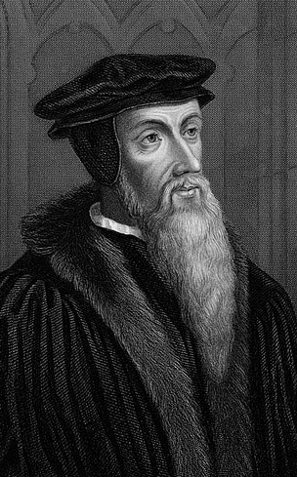
Calvinist Protestantism, and the International Reform Movement of the 1500s also supported industry and the growth of capitalism with its emphasis on predestination, respect for property and individualism.

Slide 21
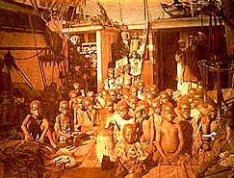
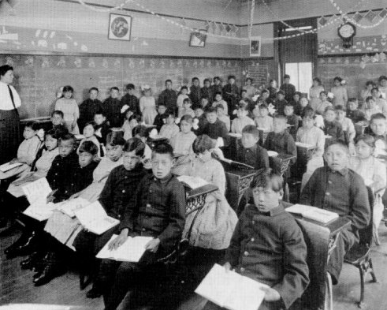
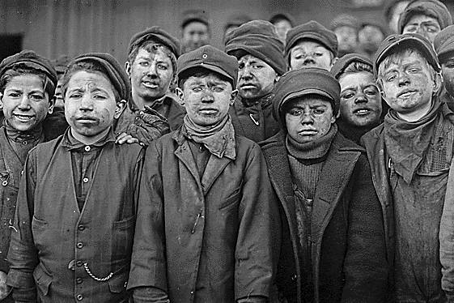
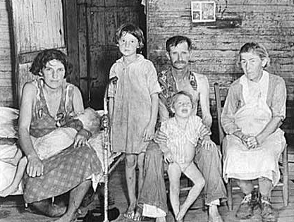

Slide 22
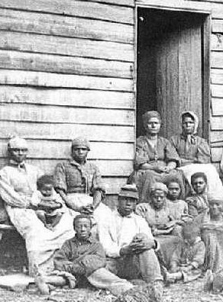
EDUCATION OUTLAWED FOR ENSLAVED CHILDREN & BLACK SCHOOLS ATTACKED EVERYWHERE
1619 first shipment of Africans stolen for slave labor arrives in Virginia. Reading is outlawed for all slaves, by punishment of death, because literacy strengthens control over enslaved peoples and limits ability to communicate, organize and challenge illegalities of system.

Slide 23
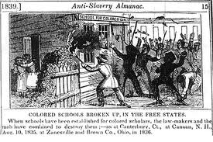

Slide 24
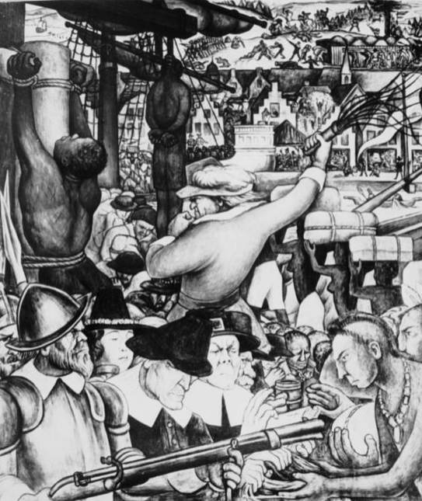
EDUCATIONAL TRACKING IN THE COLONIES
As the New England Colonies were settled, educational tracking determined that there was no education, forced apprenticeships, indentured servitude, or slavery for poor classes, basic skills training and literacy for the small middle class, and classics-based, college preparatory education for the upper class.

Slide 25
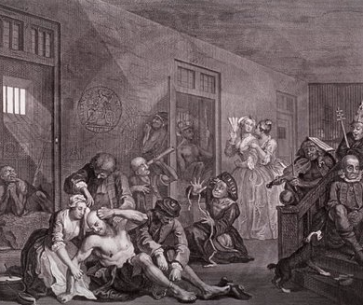
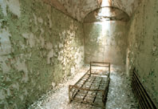
UNEMPLOYMENT WAS SEVERELY PUNISHED
The death penalty, prisons, asylums, poorhouses and work farms were established to isolate anyone who didn’t fit into the economy or who engaged in underground economies.
Children are kept in the same institutions and courts as adults.

Slide 26
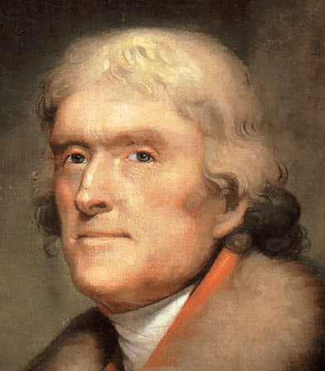
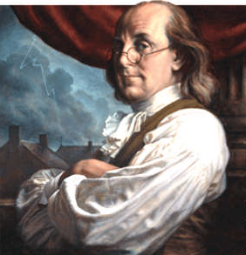
TRACKING
Thomas Jefferson and Benjamin Franklin engage in an ongoing public debate on purpose of public schooling - Franklin wins; schools are to build workforce for the new nation.

Slide 27
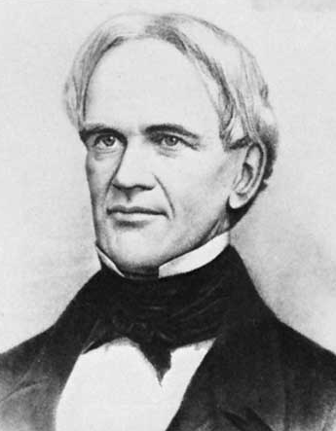
INDUSTRIAL REVOLUTION
As the Nation’s first well-known State Secretary of Education, Horace Mann argued in 1837 that public education’s goals are to create an “industrious class of women and men” who obey the law and are diligent in their work.” For factory and mining work, only basic literacy was required. By 1860, there were no more than 300 high schools in the United States, less than 100 of them free. The public education system designed by Franklin and promoted by Mann is still the standard public school curriculum today.

Slide 28
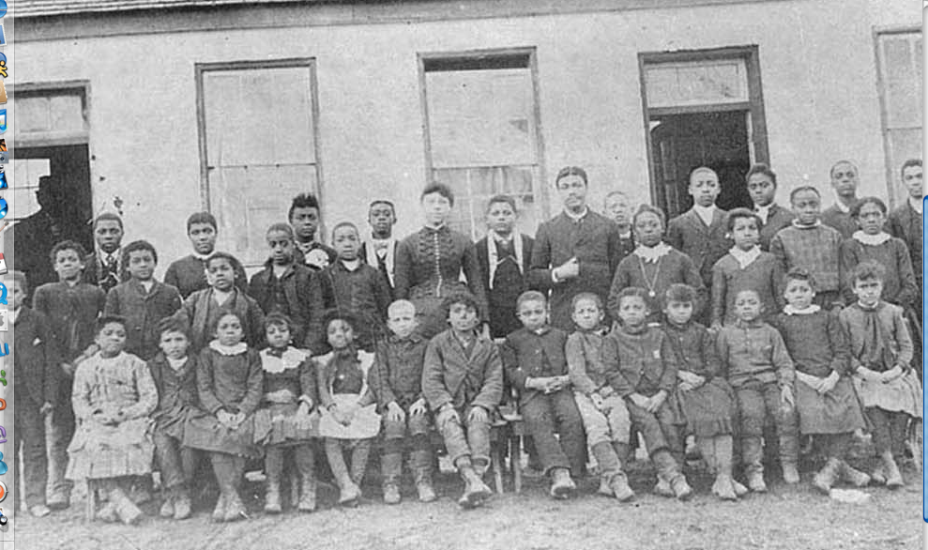
RECONSTRUCTION
After the Civil War, the North’s control of the Southern economy required an educated Black electorate. Free public schools are established for “freedmen” of all ages. But this also led to the creation of public schools for white children also. Blacks, as well as poor and working class whites receive public education for the first time in the nation’s history.

Slide 29
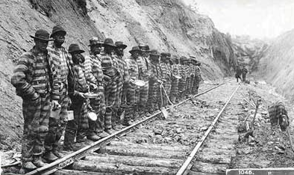
THIRTEENTH AMENDMENT LEGALIZES SLAVERY
THE THIRTEENTH AMENDMENT outlaws slavery except as a punishment for crime. Work farms, chain gangs, prisons and reform schools expand throughout the south and re-enslave the Black population. A similar expansion of these systems throughout the nation targets people of color, poor youth and immigrants. Agribusiness, the mining industry and factories all benefit from prison labor.

Slide 30
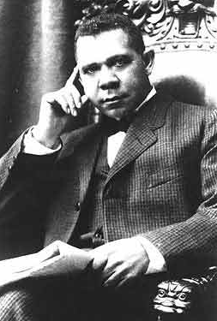
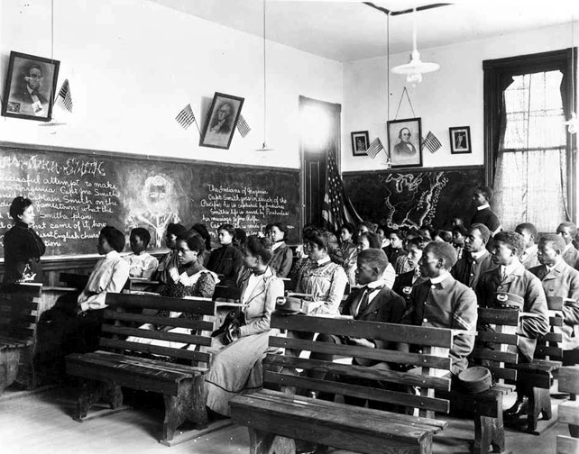
POST CIVIL WAR TRACKING
Frederick Douglass and Booker T. Washington engage in the same debate as Jefferson and Franklin, with Douglass arguing that Blacks should have access to colleges and university prep, classics education, and Washington arguing for agricultural and technical schools. Washington’s arguments support the needs of capitalism, and Black public schools and colleges prepare people for work.

Slide 31
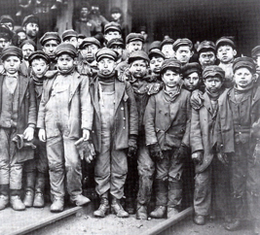
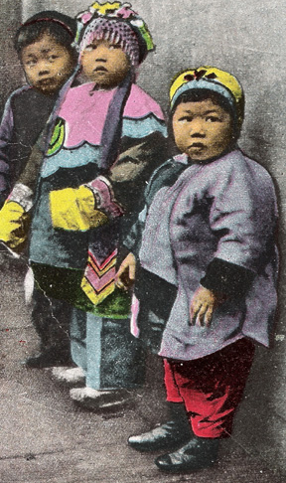
COMMITTEE OF TEN, NATIONAL EDUCATION ASSOCIATION, 1892 & PLESSY VS. FERGUSON, 1896
Recommendation by NEA that all youth get 8 years elementary school and 4 years high school was not followed until the end of WWI since the economy required cheap, unskilled work force. Separate but equal, allowed for racial segregation -- including in public schools. This strengthened the tradition of inferior basic education for youth of color and poor white youth.

Slide 32
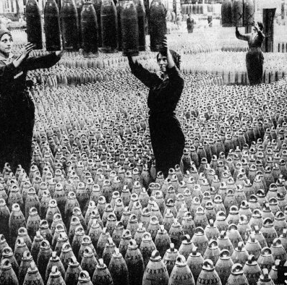
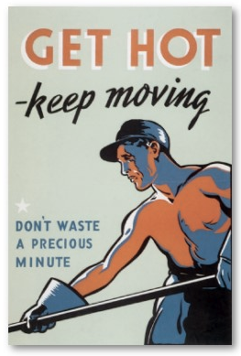
AT THE END OF WWI, NEW TECHNOLOGY REQUIRES HIGHER SKILLS. SCHOOLS ARE BUILT AND ORGANIZED LIKE FACTORIES.
The NEA creates the Commission on the Reorganization of Secondary Education. In 1918, 36 states enact attendance laws that mandate school attendance until the age of 17.

Slide 33
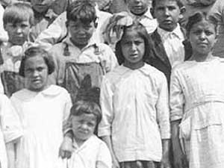
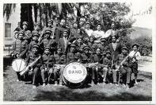
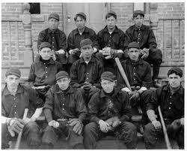
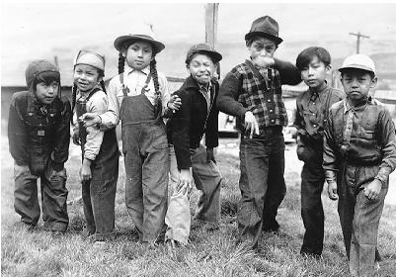
By 1932, 1/3 of all native children were forced into boarding schools, where hair was cut; western clothes were required; Indian languages, cultural traditions and religions were forbidden; and contact from family and community was cut off for years until the child reached adulthood.

Slide 34
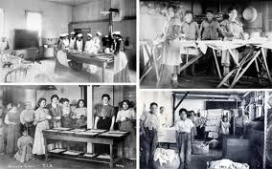
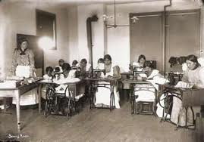
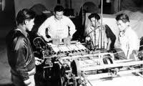
The majority of the day was engaged in manual labor, not education.

Slide 35
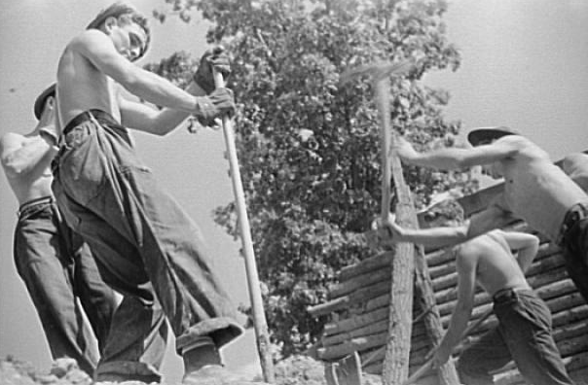
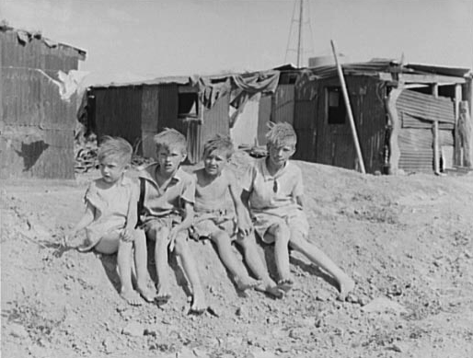
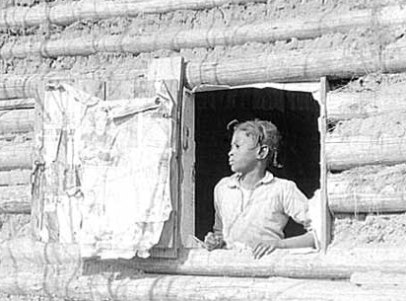
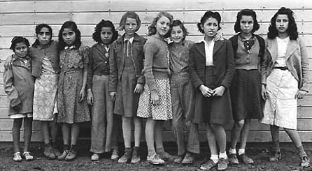
As the majority of the white population experiences widespread poverty and famine, the U.S. establishes its first social safety net with the creation of jobs programs, welfare, medical care, and social security. The massive expansion of public education through the National Youth Administration gives most American youth access to high school for the first time.

Slide 36
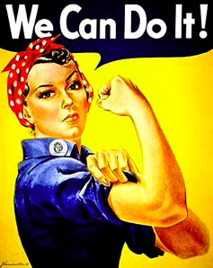
WWII: AGAIN, WAR DEMANDS HIGHER TECH NEEDS, AND REQUIRES THE NATION TO RELY ON THE MAJORITY OF WOMEN TO GO TO WORK.
New emphasis is placed on technical training for girls and women.

Slide 37
THE SPACE RACE.
When the Soviets are the first to launch a rocket into space, corporate competition fuel nationwide fear of communism. Federal funds to public education push for advanced instruction in science and technology. For the first time in U.S. history, there is a government and industry push for working and middle class youth to go to college.

Slide 38
1950s/1960s NEW EMPHASIS ON TRAINING YOUTH TO BOTH WORK AND CONSUME.
1950s prosperity and the infusion of women and returning soldiers into the workforce as a result of WWII, pushes youth from labor to consumers, Schools mandate consumer education courses. Popular culture -- TV, radio, music and film -- all push youth to buy.

Slide 39
POPULAR CULTURE TAKES OVER CLASSICS AS THE MAIN SOURCE OF YOUTH ENTERTAINMENT AND LEARNING.

Slide 40
FROM 1950 ON, YOUNGER GENERATIONS GET MORE OF THEIR INFORMATION FROM CORPORATE AMERICA THAN FROM SCHOOL .

Slide 41
CORPORATIONSUSE PUBLIC SCHOOLS TO PUSH THEIR PRODUCTS.
FAST FOOD ON CAMPUSES.
CHANNEL 1 TV PROGRAMMING IN SCHOOLS PUSHES PRODUCTS.
ADVERTSING GEARED TO YOUTH CONSUMERS ALSO PLACED ON SCHOOL PRODUCTS, EQUIPMENT AND BUILDINGS.

Slide 42
70s, 80s, 90s TRACKING LEADS TO CREATION OF MAGNATE HIGH SCHOOLS, GREATER RACIAL AND CLASS SEGREGATION, THE BEGINNING OF MASS PUSH-OUT FROM SCHOOLS TO STREETS & PRISONS.
FOR THE FIRST TIME IN US HISTORY, THERE IS NO ROLE FOR WORKING CLASS YOUTH IN THE US ECONOMY. MASSIVE SEGMENTS OF YOUTH POPULATION ARE CONSIDERED DISPOSABLE BY CORPORATE AMERICA.
MASSIVE DEINDUSTRIALIZATION AND OUT-SOURCING OF AMERICAN JOBS. RECESSION, REAGANOMICS, ANTI-TAX MOVEMENT ALL LEAD TO MASSIVE BUDGET CUTS TO SCHOOLS AND HUMAN SERVICES. BUILD UP OF PRISON INDUSTRIAL COMPLEX AND USE OF PRISONERS AS THE NEWEST SLAVE LABOR. AIDS, CRACK, HOMELESSNESS HIT URBAN AND RURAL AMERICA . ANTI-IMMIGRANT BACKLASH SWEEPS THE NATION, INCLUDING DETENTION AND DEPORTATION.

Slide 43
“DROP-OUT FACTORIES” LOOK AND OPERATE LIKE PRISONS AT THE SAME TIME THAT CORPORATIONS MOVE IN A BIG WAY INTO PRISON INVESTMENT. CORRECTIONS CORPORATION OF AMERICA AND SIMILAR COMPANIES EXPERIENCE LARGEST STOCK MARKET GROWTH OF ANY INDUSTRY.

Slide 44
90s/00s PRIVATIZATION OF PUBLIC EDUCATION.
CORPORATE LEADERS CREATE EDUCATION THINK TANKS, FOUNDATIONS FOCUSING ON SCHOOL REFORM, AND (IN SOME CASES) ARE HIRED TO RUN SCHOOL DISTRICTS.
CHARTER SCHOOL COMPANIES SEE EDUCATION AS A FOR-PROFIT VENTURE. CORPORATIONS LEARN THE MASS MOVEMENTS STRATEGIES OF THE LEFT TO CREATE PARENT MOVEMENST TO SUPPORT THE TAKEOVER OF SCHOOLS.
PUSH OUT AND CRIMINALIZATION OF STUDENTS EXPANDS AS ANY STUDENT WHO CHALLENGES EDUCATORS IS CONSIDERED A FINANCIAL LIABILITY. SCHOOL PUSH OUT ESCALATES.
GEORGE BUSH’S NO CHILD LEFT BEHIND INSTITUTES NATIONAL HIGH STAKES TESTING.
2006: MAYOR VILLARAIGOSA’S SOUTH L.A. SCHOOL TAKEOVER IN COALITION WITH THE GREEN DOT PUBLIC SCHOOLS CORPORATION.

Slide 45
2009 - No Child Left Behind morphs into Race to the Top
Notes:
45

Slide 46
PUBLIC EDUCATION TO BUILD U.S. PATRIOTISM & EXERT SOCIAL CONTROL

Slide 47
COLONIAL COURTS, SCHOOLS & PRISONS SEVERE Especially for youth, women and people of color, resistance is punished by banishment, torture and death.

Slide 48
REPRESSION OF BLACK AND BROWN COMMUNITIES WITH LAW ENFORCEMENT BACKING OR DIRECTION Blacks who learned to read or taught others were tortured and killed. 1876 KKK founded to uphold Jim Crow segregation, including separate and inferior schools and colleges. Highest lynching rates in California during 1800s and early 1900s; then in South from 1910 on.

Slide 49
4 SOLUTIONS TO “INDIAN PROBLEM” CONGRESS DEBATES AND IMPLEMENTS FOUR STRATEGIES IN THE CONQUEST OF INDIAN LAND: 1. WAR AND MASSACRE 2. STARVATION 3. FORCED ASSIMILATION THROUGH RESERVATIONS, GOVERNMENT BOARDING SCHOOLS AND OUTLAWING OF INDIAN RELIGION AND CULTURE 4. ADDICTION

Slide 50
“KILL THE INDIAN, SAVE THE MAN.” Captain Richard Henry Pratt, 10th Calvary Buffalo Soldiers, establishes the widespread expansion of government boarding school system, and children are stolen from their communities and taken hundreds to thousands of miles from their communities.

Slide 51
“UNWASHED MASSES” Immigrant youth were exploited as cheap labor, and pushed to assimilate into American culture. Many of those who ended up on the street were starved, killed, incarcerated, institutionalized or sent west.

Slide 52
RACE-BASED IMMIGRATION QUOTAS
1882: The U.S. established its first federal anti-immigrant laws with the Chinese Exclusion Act. As with other immigrants before them, when Asian youth eventually gained access to public schools, their names were changed, they were punished for speaking their language, and learned nothing of the contributions of their community to America.

Slide 53
The Settlement House Movement (f. 1884) and Children’s Aid Society (f. 1853) which created the Orphan Trains were the roots of foster care and social work in the U.S. These models worked to Americanize and assimilate immigrant youth.

Slide 54
Classroom Management With strict discipline, “one who studies educational theory can see in the mechanical routine of the classroom, the educative forces that are slowly transforming the child from a little savage into a creature fit for law and order, fit for the life of civilized society.” - 1907
William Chandler Bagley

Slide 55
POPULAR CULTURE AND GOVERNMENT PROPAGANDA PROMOTE RACISM AND ANTI-YOUTH PREJUDICE. Early drug wars and Prohibition criminalize people of color and blame Black, Brown and Asian communities and culture for corruption of white youth. First talking movie - The Jazz Singer - and first cartoons reflect mass popularity of “Black Face” in popular culture, and widespread support of Jim Crow and other racist legislation. KKK membership highest in US history with release of Birth of Nation. 1918 - Cardinal Principles of Secondary Education pass national adoption of curriculum in democracy, citizenship and, for young women, home economics. Teachers are required to take loyalty oaths, citizenship tests and certification.

Slide 57
After World War I, with less need for youth in the workforce and military, youth and youth culture (music, dance, speech, dress) is seen as immoral. Jazz is blamed as a corrupter of white youth, just as Rock and Roll will be blamed in the 50s and Hip Hop in the 80s.

Slide 58
During the war, youth are seen as heroes, but those marginalized from war effort face extreme repression…

Slide 59
WAR-TIME REPRESSION Sleepy Lagoon Trial and Sailor (a.k.a. Zoot Suit) Riots Internment of Japanese community; confiscation of all savings, businesses and property. U.S. launches the world’s first nuclear strike on Japan. African American, Latino, Native American and Asian soldiers return home from the war to face same race discrimination including segregated schools and higher education.

Slide 60
With World War II over and a prosperous post-war economy, youth are once again disposable, feared and made to look like villains. Films show youth as violent criminals. Popular youth culture gives rise to industry theft of R&B and bluegrass/mountain music to establish Rock and Roll. Educators, government, and sociologists begin labeling youth based on pathologies, including terms like school drop out. Creation of youth prevention and intervention professions, gang and street outreach programs, expansion of youth farms, reform schools and juvenile prisons.

Slide 61
> House Un-American Activities Committee leads to firing and blacklisting of thousands of teachers; requires teachers nationwide to take loyalty oaths . > U.S. invades Dominican Republic, Korea and sends “advisors” into Vietnam. First atomic submarine is launched. Cold War and Domino Theory in full effect. > School children practice nuclear bomb drills, wear dog tags, and Americans build bomb shelters in public schools and suburban back yards. > Russians launch Sputnik and U.S. panics -founds NASA and invests millions in math and science instruction for public schools.

Slide 66
After the student-led Civil Rights, Black and Brown Power, American Indian and anti-war movements of the 1950s, 1960s, and early 70s, Richard Nixon’s law and order backlash inspired a return to traditional education aimed at the “three Rs,” harsh discipline, discouragement of free speech in schools including censoring or eliminating student newspapers, and discouraging classroom discussion and debate.

Slide 67
With the end to a mandatory draft after the Vietnam War, the military expanded JROTCs and recruitment on high school campuses in poor and working class communities. The draft was replaced by the poverty draft.

Slide 68
2010

Slide 69
LAUSD JROTC, Los Angeles, CA
Granbury HS, Granbury, Texas
Chaparral HS, San Diego, CA
Northwest HS, Clarksville, Tennessee

Slide 70
U.S. PUBLIC SAFETY AND EDUCATION POLICIES MOST WITH ROOTS IN L.A. Nixon’s Law and Order backlash after 60s movements leads to mass incarceration of poor people and people of color. In California, the prison population increases 700% in 20 years. Cali and L.A. lead the world in incarceration and harsh sentencing, including creation of Prop 21 and Three Strikes, and export these policies across U.S. Reaganomics and the War on Drugs. Anti-tax movement and Prop 13. Just Say No. Darryl Gates introduces military-style policing (including SWAT and CRASH) to inner city L.A. Police and Probation Departments begin to take over schools discipline and security. Drug Czar William Bennett institute first zero tolerance policies in public schools. U.S. fuels wars against rebellions in Central America. LAPD and Sheriffs work with U.S. military to teach counter-guerilla tactics, interrogation and torture. Later return to teach gang suppression. Anti-immigrant and English-only legislation are passed, including denying immigrant youth access to education and financial aid. Gang suppression tactics -- gang definitions, gang databases and injunctions -- mass deportations of alleged gang members and labeling of gangs as urban/street terrorists.

Slide 72
PRESIDENT REAGAN APPOINTS WILLIAM BENNET AS U.S. SECRETARY OF EDUCATION. Zero Tolerance policies include requirements for suspension, expulsion and arrests; the takeover of school discipline by police departments; and relationships in schools replaced by metal detectors, locker searches, drug-sniffing dogs, and security gates.

Slide 74
In the 1970s, California was #1 in school spending and had one of the best school systems in the world. Now, California is #1 in prison spending, and with this year’s budget cuts, dropped from #47 to #50 in school spending! South and East L.A. lead the nation in school overcrowding, low test scores and drop-out/push-out rates with only 40% of students graduating.
#50
Notes:
74

Slide 75
THE SCHOOL TO JAIL TRACK HAS CONTRIBUTED TO CALI’S ADDICTION TO INCARCERATION.
Notes:
75
There are now 0 youth prisoners in other countries .
75

Slide 76
2010
CALI HAS 176 THOUSAND STATE PRISONERS. 40% ARE FROM L.A. COUNTY.
Notes:
76
76

Slide 77
IN THE EARLY 80s, CALIFORNIA STARTED TO RAPIDLY EXPAND THE BUILDING OF PRISONS AND CUT THE BUDGET TO EVERYTHING ELSE.
Notes:
77
77

Slide 78
Notes:
78
78

Slide 79
Notes:
79
79

Slide 80
Notes:
80
80

Slide 81
Notes:
81
81

Slide 82
Notes:
82
82

Slide 83
Notes:
83
83

Slide 84
Notes:
84
84

Slide 85
Notes:
85
85

Slide 86
Notes:
86
86

Slide 87
Notes:
87
87

Slide 88
Notes:
88
88

Slide 89
Notes:
89
89

Slide 90
Notes:
90
90

Slide 91
Notes:
91
91

Slide 92
Notes:
92
92

Slide 93
Notes:
93
93

Slide 94
Notes:
94
94

Slide 95
Notes:
95
95

Slide 96
Notes:
96
96

Slide 97
Notes:
97
97

Slide 98
Notes:
98
98

Slide 99
DURING THAT SAME TIME, CALIFORNIA BUILT ONE UNIVERSITY.
Notes:
99
99

Slide 100
Just 1% of L.A.’s Courts, Police, Sheriffs’ District Attorney’s, Probation’s and City Attorney’s Budgets would pay for: 500 full-time gang intervention workers; 50 youth centers open from 3pm - midnight, 365 days a year; and 25,000 youth jobs!
Notes:
100
100

Slide 101
PUBLIC EDUCATION for LIBERATION

Slide 102
RESISTANCE
1600s - 1800s - Native Americans protect culture, religion and education by attempting to negotiate treaties, going to war against the U.S., and taking traditions underground.

Slide 103
RESISTANCE
In the colonies, Quakers establish circular, non-hierarchical schools, churches and town halls where all can speak and make decisions. Also denounce slavery and the genocide of native people.

Slide 104
RESISTANCE
From the first stolen life, Africans resisted slavery and used language, drums, rebellions to fight for the right to freedom including freedom to speak out, communicate, learn and teach.

Slide 105
RESISTANCE
In the 1780s, Benjamin Banneker advocated for education and voting rights for all.

Slide 106
RESISTANCE
Sequoia develops first written language among North America’s indigenous people and Cherokee Nation establishes first Native American owned and operated university.

Slide 107
RESISTANCE
Midnight Schools established in Black communities to secretly teach literacy. Frederick Douglass, Sojourner Truth and other Black abolitionists promote that African Americans speak for themselves, strive toward university education, and publish their own narratives and newspapers.

Slide 108
RESISTANCE
Barred from colleges and universities, women in the early 1800s began to dominate teaching positions in elementary education. Often only in their teens, they began to publish women’s periodicals and eventually formed much of the movement for women’s rights including pushing for the rights to higher education and to vote.

Slide 109
RESISTANCE

Slide 110
RESISTANCE
1800s: New immigrants resisted total assimilation and created bilingual schools. In the Midwest and Northeast, many schools still exist more than 100 years later.

Slide 112
RESISTANCE
SCHOOL FOR ALL
Mother Jones, child factory workers and the Labor Movement fight to end Child Labor and push for universal public education.

Slide 115
RESISTANCE
1890s: Self-taught laborers Henry George, Progress and Poverty and Edward Bellamy, Looking Backward published books advocating equality and universal public education.

Slide 116
RESISTANCE
1920s and 1930s: Harlem Renaissance gives rise to unprecedented creation of Black literature, arts, and commerce, and provides the voice for a growing Civil Rights Movement that includes demands for equal education.

Slide 117
RESISTANCE
1945: Black, Brown, Asian, Native American and working class white soldiers return home from WWII and demand racial and economic equality including access to higher education. Push leads to establishment of GI Bill, the largest college access opportunity in the nation’s history, and lifts millions of families into the middle class.

Slide 118
RESISTANCE
1930s - 1960s: throughout the southwest, Pilipino, Mexican and (white) American farm workers established schools and encouraged families to take their children out of the fields and fight for the right to free public education. In California, the United Farm Workers grew out of this struggle and won educational access for migrant children and youth.

Slide 119
RESISTANCE
Mendez, et al v. Westminster School District, (9th Cir. 1947) was a 1946 federal court case that challenged racial segregation in Orange County, California schools. In its ruling, the United States Court of Appeals for the Ninth Circuit held that the segregation of Mexican and Mexican American students into separate "Mexican schools" was unconstitutional.

Slide 120
RESISTANCE
1950s - 1970s: End of the Boarding School system and forced adoption of Indian Children to expose and reclaim the “lost generations.”

Slide 121
RESISTANCE
1954: The Brown v. Board of Education decision of the United States Supreme Court declared that state laws establishing separate public schools for black and white students were unconstitutional. The decision overturned the Court’s Plessey v. Ferguson decision of 1896 which allowed state-sponsored segregation. Little Rock 9, James Meredith and thousands of unknown youth heroes take the first dangerous steps into white schools.

Slide 122
RESISTANCE
1960: The State of California enacted the Master plan for Higher Education, the largest commitment to higher education ever made in the world. It promised that a place would be available in the state’s college and university system for every high school graduate or person otherwise qualified. LAUSD HAD A 80% GRADUATION RATE.

Slide 123
RESISTANCE
1963: Student Nonviolent Coordinating Committee creates Freedom Schools to focus on literacy, youth leadership development and popular education in their work for Black liberation and voting rights in the south.

Slide 126
RESISTANCE
United Mexican American Students, the Brown Berets and Chicano teachers provide leadership training and organizing support to high school students in East L.A. leading to the 1968 High School Walk Outs (also known as the Blow Outs). As many as 20,000 students participate, forcing LAUSD to implement Chicano Studies, hiring of Chicano teachers and administrators, and improvements in school conditions and college access.

Slide 128
RESISTANCE
1969: Black Panthers create community schools, as well as the nation’s first free breakfast programs. (The Young Lords also establish free breakfast programs.) The U.S. government copied the breakfast program nationwide, and it is still in operation today.

Slide 129
RESISTANCE
1960s/70s: American Indian Movement protects communities as they re-establish traditional warrior schools, religious and cultural teachings 80 years after they were outlawed by U.S.

Slide 130
RESISTANCE
1992: After the hate murder of a Black youth by a white mob in Brooklyn, NYC Students and teachers push for the nation’s first curricula to teach “tolerance” district-wide. The Rainbow Curricula also includes LGBT2Q² Studies for the first time.

Slide 131
RESISTANCE
1970s - 2000s: Expansion of American Indian Studies Programs and Colleges. Challenges to the use of Indian people as mascots in schools and professional sports leads to some changes and awareness.

Slide 132
WE ARE RESISTING!

Slide 133
HOW DOES THIS HISTORY IMPACT OUR WORK? What does this history mean for us? How are these traditions still at work in the creation of public education? What policies can we expect in the future? What can we do to continue to promote education for liberation?

